Slide 1




Delta Airlines Data Analysis
Objective: Leverage Data for Operational Efficiency and Customer Retention

Slide 2

OBJECTIVES:
Assimilate the data, and leverage AI and CRM solutions to gain comprehensive insights.
Data cleaning, descriptive analysis, data modeling, and recommendation
GOAL: Develop a 5-year business strategy that addresses market dynamics and regulatory requirements and keeps their competitive edge in the industry.
- Tools Used: Python, Google CoLab, GitHub

Slide 3

Cleaned and standardized Frequent Flier, Upcoming Flights, 3-Month Upcoming Flights
Converted date and time columns to a consistent format.
Encoded categorical data (e.g., Departure & Arrival Cities).
Filled missing values and removed duplicates.

Slide 4
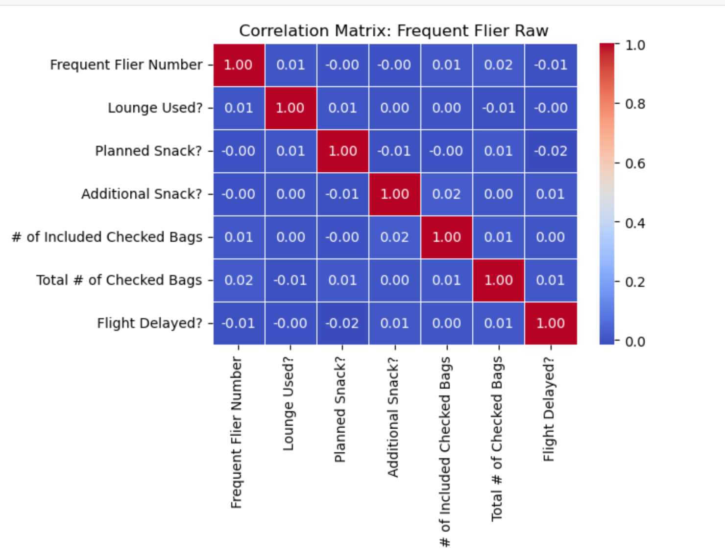
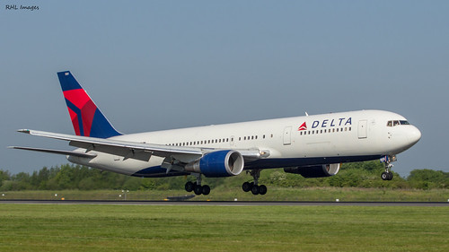
Correlation Matrices
Frequent Flier Raw (FFR)
Low Correlation Across Variables: Most variables show weak correlations, indicating limited influence on each other within this dataset.
Checked Bags Relationship: A slight positive correlation exists between the # of Included Checked Bags and Total # of Checked Bags, which aligns with baggage policies and allows for straightforward passenger segmentation based on baggage usage.
Frequent Flier Number: This variable shows little connection to other customer engagement or spending indicators, suggesting that flight frequency alone may not predict additional service purchases.

Slide 5
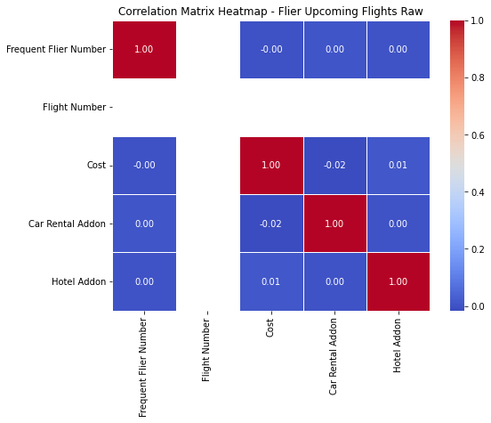
Correlation Matrices
Flier Upcoming Flights Raw (FUFR)
Cost and Add-Ons: A positive correlation is present between Cost and both Car Rental Addon and Hotel Addon, indicating that higher spenders are more likely to purchase additional services—supporting the idea of bundling promotions.
Frequent Flier Number and Spending: Weak correlations with spending variables suggest frequent flier status doesn’t directly predict additional spending, indicating room to personalize add-on offers for loyalty members.
Departure and Arrival Times: These operational details show expected weak correlations with other variables; however, they could reveal seasonal patterns if analyzed over time.

Slide 6
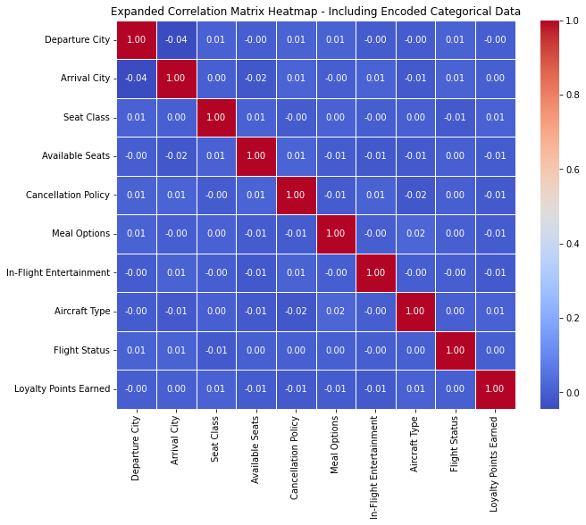
Correlation Matrices
3 Month Upcoming Flights Raw
Weak Relationships Across All Pairs: Most correlations are close to zero, indicating that variables like Departure City, Arrival City, Seat Class, Cancellation Policy, Meal Options, and In-Flight Entertainment show minimal linear relationships with each other.
Loyalty Points Earned: There is no significant correlation between Loyalty Points Earned and other factors such as Available Seats, Seat Class, or Flight Status, suggesting that loyalty points are not strongly impacted by these flight-specific attributes.
Flight Status: Flight Status has weak, non-significant correlations with all other variables, implying that flight outcomes (e.g., delays) do not relate closely to any specific factors in this dataset.

Slide 7
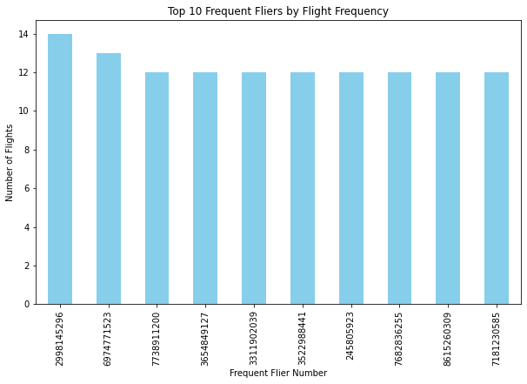
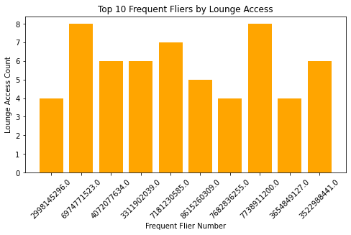
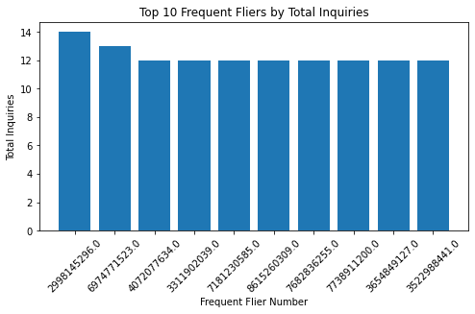
Descriptive Analysis
Top 10 frequent flier by flight frequency
Top 10 frequent flier by lounge access
Top 10 frequent flier by total inquiries

Slide 8
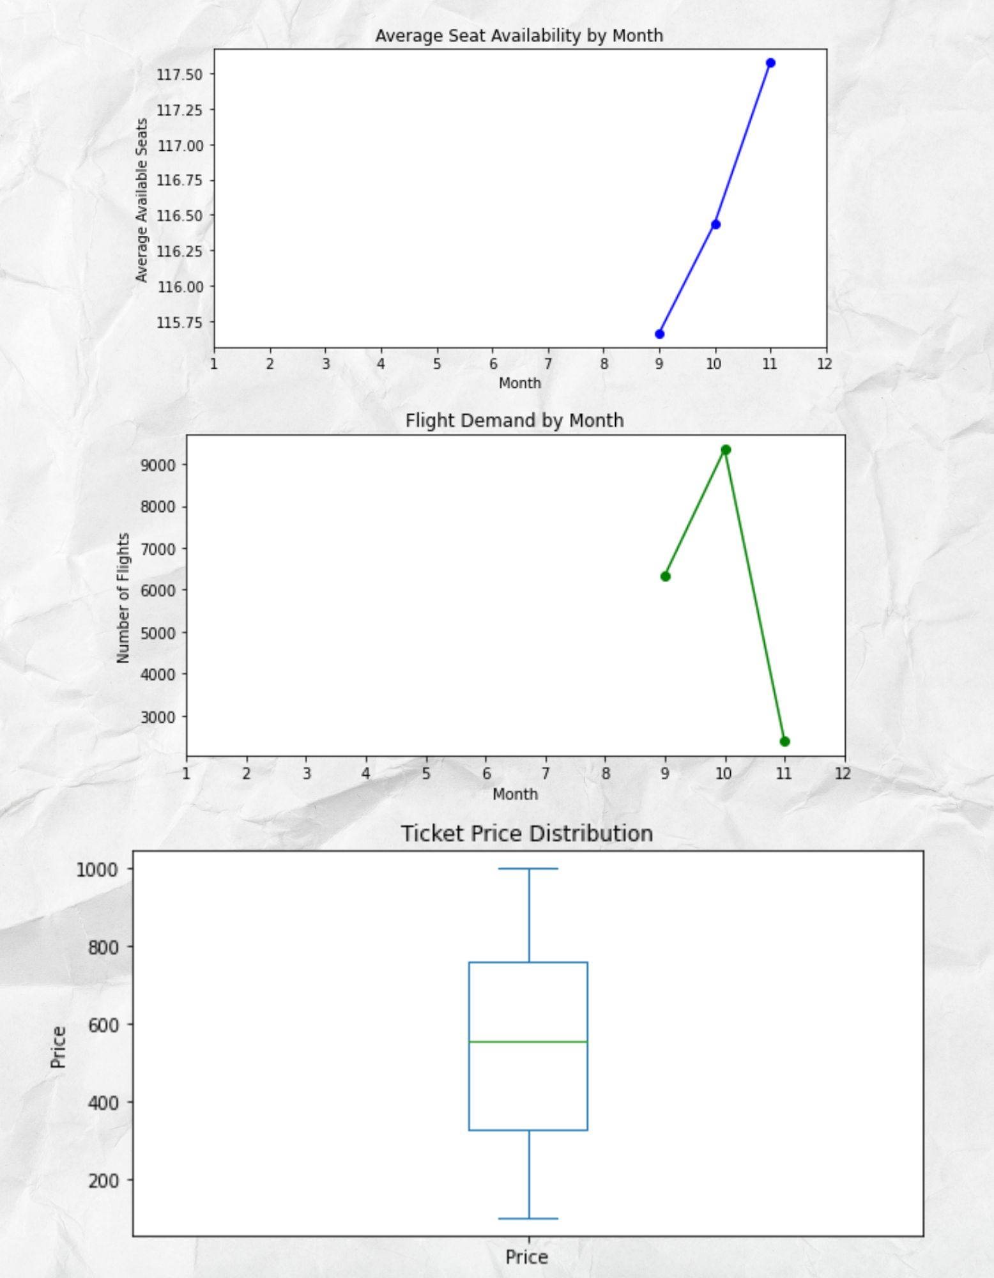
Descriptive Analysis (2)
Average seat availability by Month
Flight demand by month
Ticket price distribution
Notes:
The line plot of monthly flight demand shows the number of flights scheduled for each month.
Interpretation: Peaks and dips in the graph highlight seasonal or monthly demand trends.
This line plot visualizes the average number of available seats per month.
Interpretation: Patterns in seat availability can reveal times of surplus capacity or high occupancy:
targeted campaigns (such as discounts for loyalty members or upgrades) could improve occupancy rates.
Ticket Price Distribution
Description: The boxplot of ticket prices shows the spread, median, and potential outliers in the price data.
Interpretation:
Median and Range: The central line within the box represents the median ticket price, while the box itself shows the interquartile range (middle 50% of prices).

Slide 9

Predictive Model for Loyalty Level Prediction
Hypothesis: Customer segmentation based on loyalty and engagement metrics can identify different customer types, enabling Delta to target retention strategies more effectively.
- Target Variable: High vs Low Loyalty based on Frequent Flier data.
- Features: Frequent Flier Number, Price, Loyalty Tenure.
Model: Logistic Regression to classify loyalty levels.
Customer Segmentation using unsupervised learning

Slide 10
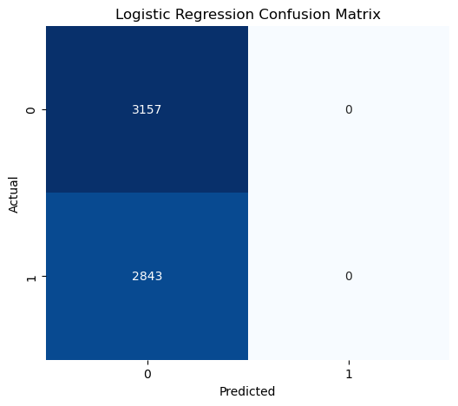
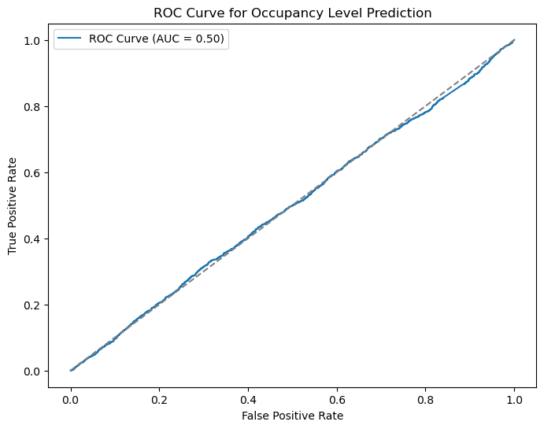
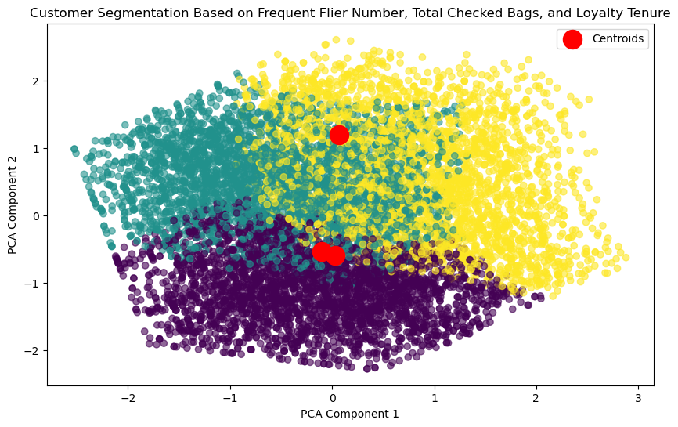
Predictive Modeling (1)
- This model does not effectively predict customer engagement, more refined features or balanced data are needed.
- The segmentation provides clear customer types for targeted strategies. High-loyalty customers can be rewarded, while low-loyalty customers may benefit from targeted promotions.
Interpretation:
1. Logistic Regression Model Metrics (Confusion Matrix and Classification Report)
Accuracy: The model achieved 52.2% accuracy, which is slightly above random chance (50%), indicating weak predictive power.
Confusion Matrix: The model only correctly predicted the "0" class (customers not likely to purchase or engage in the predicted action), missing all instances of the "1" class. This could indicate a class imbalance issue or insufficient predictive features for the target.
ROC AUC Score: 0.498, which is close to 0.5, suggesting the model performs similarly to random guessing.
Notes:
This implies the model is not effective for distinguishing between the two classes.
The PCA plot shows three distinct clusters identified by the K-Means clustering algorithm, each represented by a different color and separated in two-dimensional PCA space.
Predictive Reliability: With an ROC AUC score of 0.498, the model is almost equivalent to random guessing, indicating a need for new or improved features to enhance accuracy.

Slide 11
Predictive Modeling (2)
Seasonal fluctuations significantly impact seat occupancy rates and revenue, indicating potential for dynamic pricing and targeted promotions.
Metrics:
Occupancy Rate:
Occupancy Rate = Total Seats − Available Seats
2. Average Revenue per Seat Mile (PRASM): Use PRASM data to track seasonal revenue changes.
Delta Loyalty Customer Dataset: For Flight Date, Price, and Available Seats to analyze seasonal occupancy and pricing trends.
PRASM Data: To assess revenue trends by season, providing insights into revenue per seat mile over time.
Total Seats

Slide 12
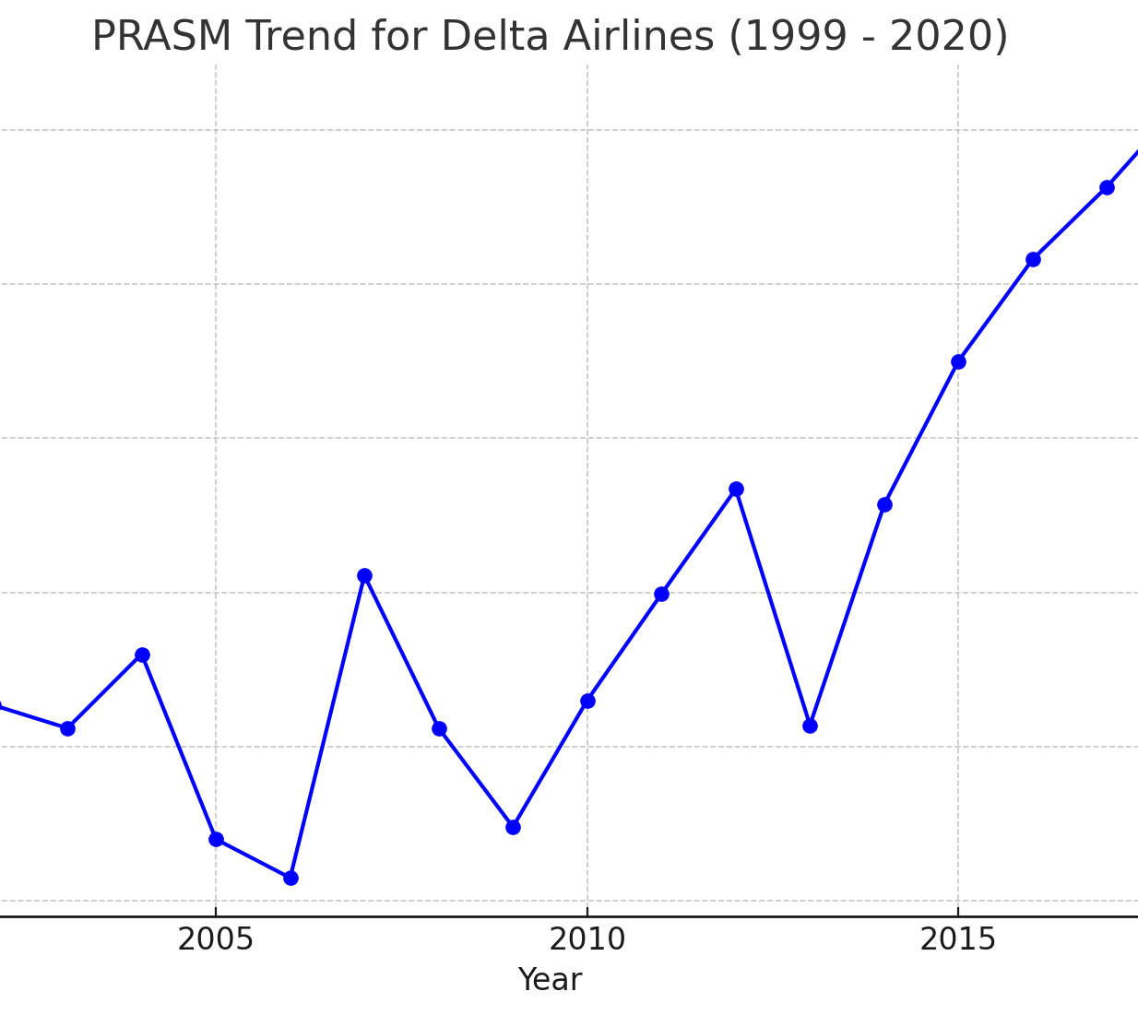
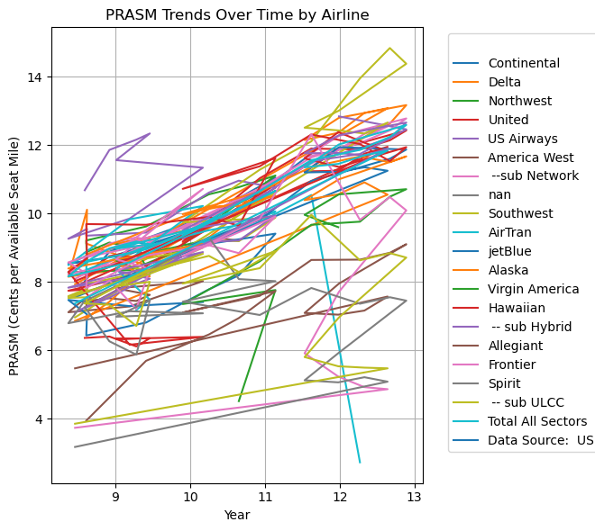
Descriptive Analysis for PRASM (how well Delta is monetizing its available seating capacity)
Revenue Peaks and Dips: Notable increases and decreases may correspond to external factors (e.g., economic recessions, fuel price changes, or competitive pressures).Stability and Growth Patterns: Periods of relative stability or growth could indicate successful revenue management or increased demand.

Slide 13
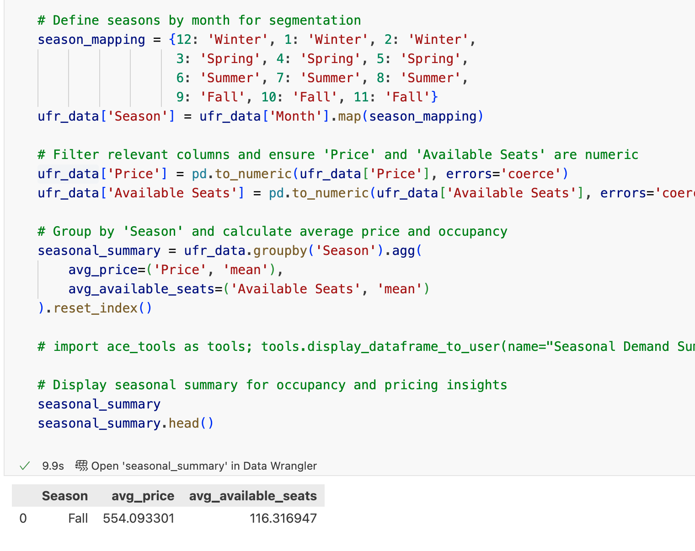
Modeling Seasonal Trends

Slide 14
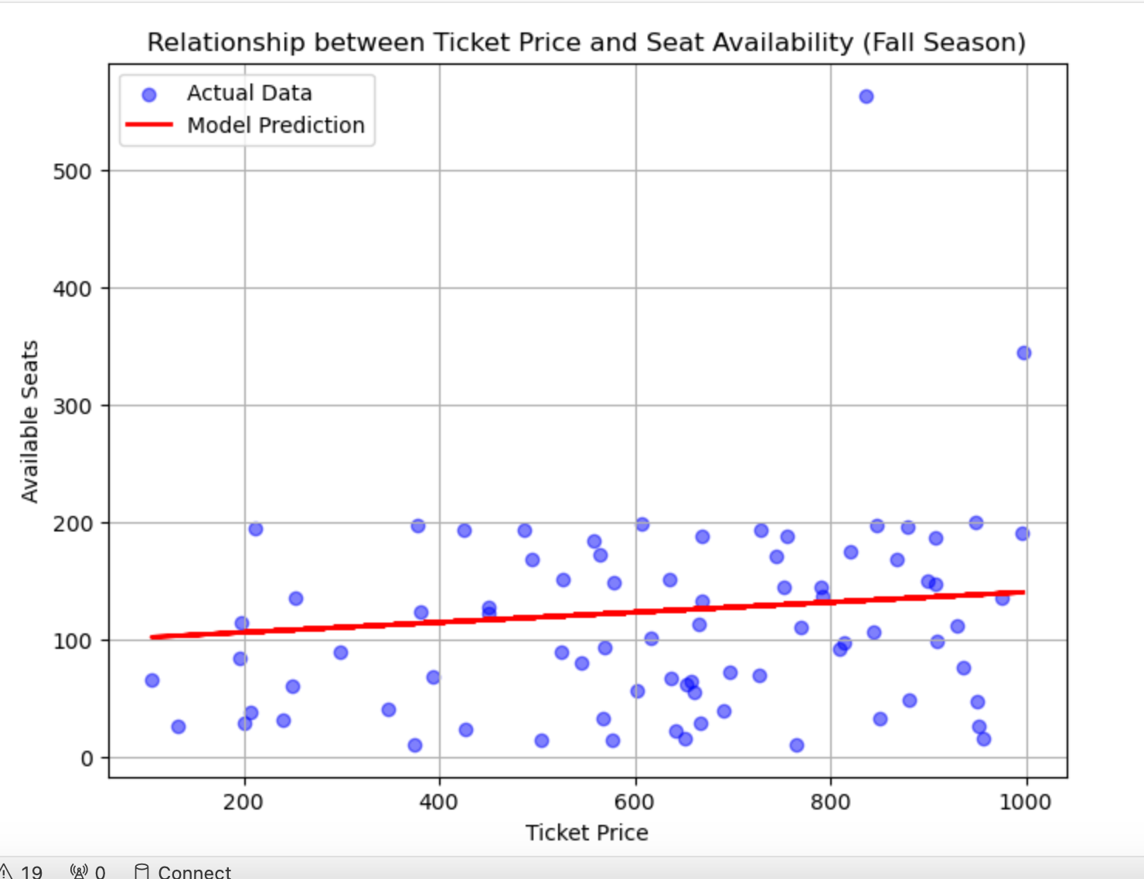
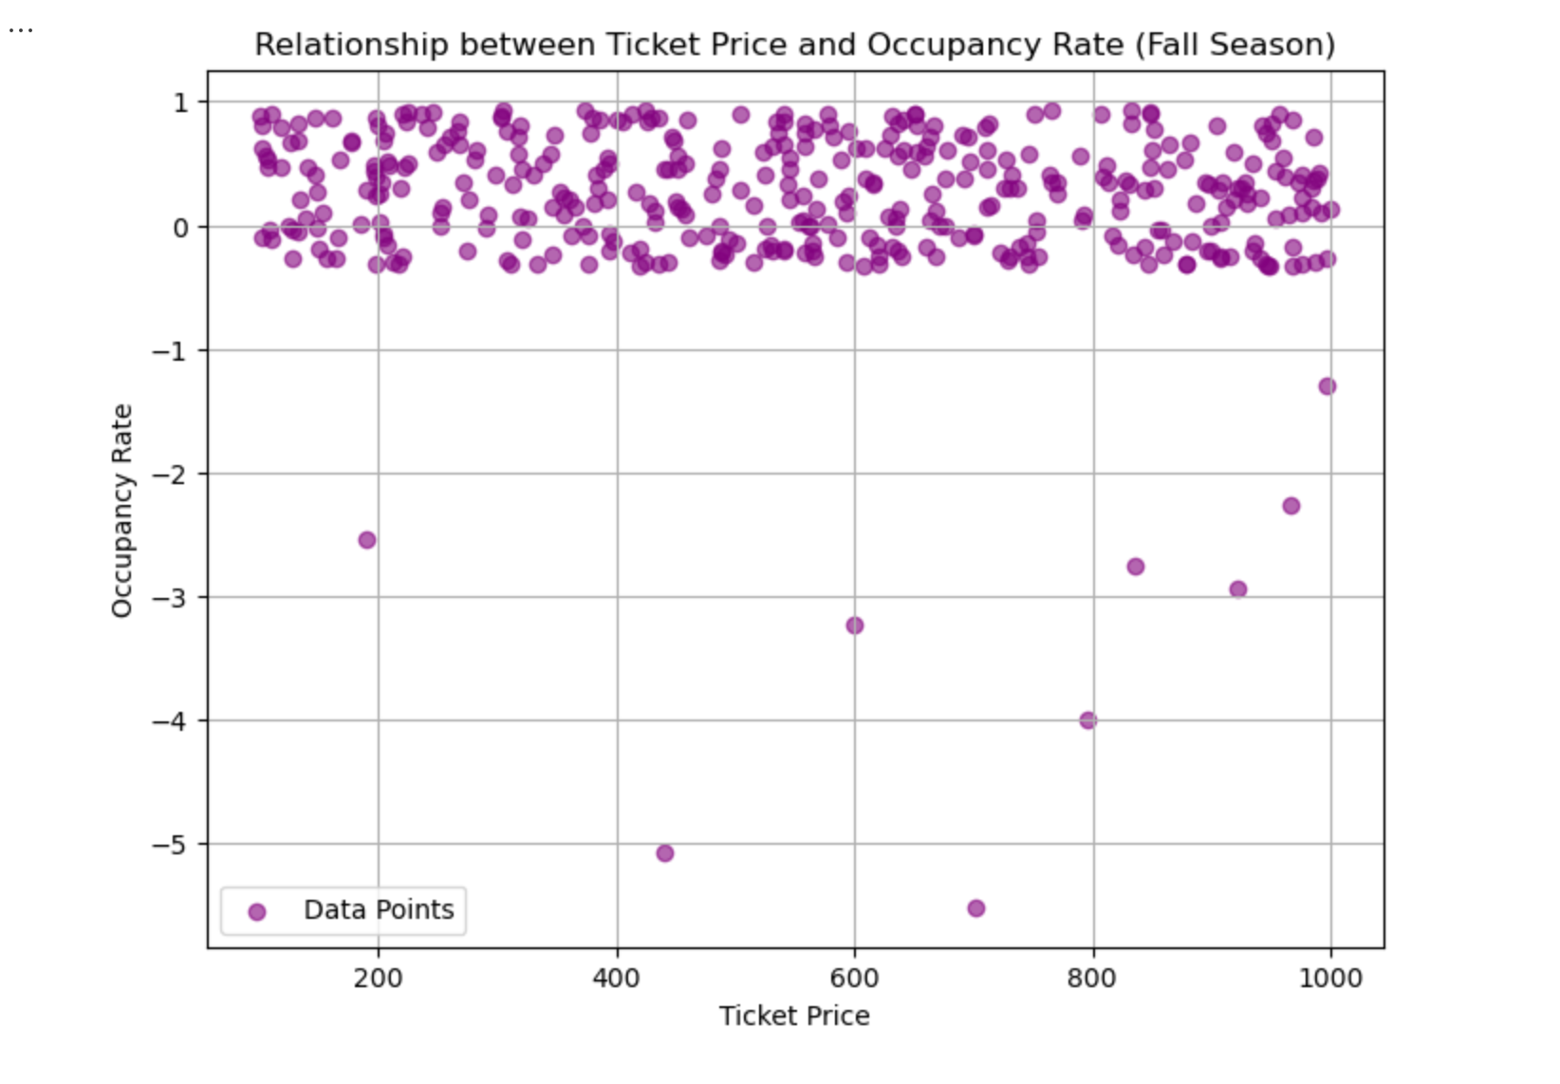
Relationship between Ticket Price and Seat availability and Occupancy rate
Observations:
Each dot represents a flight with its ticket price on the x-axis and the occupancy rate on the vertical axis
There is a weak trend showing that as prices increase slightly, the occupancy rate tends to drop a bit. However, the effect is minimal, meaning price alone doesn’t strongly affect how full flights are in the Fall season.
Notes:
Purpose of the Chart: The chart helps us see if higher or lower ticket prices impact how full the flights are (occupancy rate) the covariance between ticket price and occupancy rate is likely weakly negative. This means that as ticket prices increase, the occupancy rate tends to decrease slightly, although the effect is minimal. This aligns with the weak predictive power we observed in the model, where price alone does not significantly influence occupancy.
In simple terms, while there’s a slight inverse relationship between price and occupancy, other factors beyond ticket price are likely more impactful in determining how full flights are

Slide 15
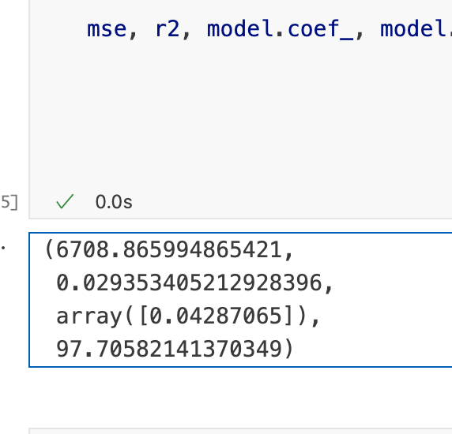
Model Evaluation
The linear regression model for predicting seat availability based on ticket price within the Fall season yields the following insights:
Mean Squared Error (MSE): 6708.87, indicating the average squared difference between predicted and actual values.
R-squared (R²): 0.029, suggesting that price alone explains only about 2.9% of the variation in available seats. This low value implies that other factors likely impact seat availability beyond ticket price alone.
Model Coefficient: 0.04290.04290.0429, meaning that for every one-unit increase in price, seat availability slightly increases (though this effect is minimal).
Intercept: 97.7197.7197.71, indicating the base level of seat availability when the ticket price is zero.

Slide 16

Understanding the Model
The model shows a weak relationship between ticket price and seat availability for Fall, suggesting that seasonal demand patterns are not strongly driven by ticket prices alone.
Spread of Points: the points are widely scattered, which shows that price alone doesn’t strongly impact occupancy rate, as other factors likely play a role.
Understanding Covariance (Conceptual)
Near Zero Covariance: there was minimal relationship, reinforcing that price changes alone don’t predict occupancy rates effectively.
To improve insights, additional features (such as route popularity, customer loyalty engagement, or multi-season data) would enhance our understanding of occupancy and revenue trends.

Slide 17


Recommendations for Delta Airlines
1. Use insights to tailor loyalty rewards for high-value customers.
2. Apply data-driven promotions to optimize low-demand periods and routes.
3. Integrate additional data for improved low-loyalty customer prediction.

Slide 18





THANK YOU TO THE CLICKED TEAM

